Slide 1
Fundamentals of Nursing(1st Stage)
Hand Hygiene
(Practice)
Lecture 1
University of Basrah –College of Nursing – Fundamentals of Nursing Department

Slide 2
Introduction
Thousands of people die everyday around the world from infections acquired while receiving health care. Hands are the main pathways of germ transmission during health care.

Slide 3
Definition
The most important and most basic technique in preventing and controlling transmission of infection is hand hygiene.
* Hand hygiene is a general term that applies to either:
1-Hand washing: refers to washing hands with plain soap and water.

Slide 4
2-Antiseptic hand wash: is defined as washing hands with water and soap or other detergents containing an antiseptic agent.

Slide 5
3-Antiseptic hand rub: means to apply an antiseptic hand rub product to all surfaces of the hands to reduce the number of microorganisms present.

Slide 6
4-Surgical hand antisepsis: is an antiseptic hand wash or Antiseptic hand rub performed preoperatively by surgical personnel to eliminate transient and reduce resident hand flora

Slide 7
* When hands are visibly dirty or contaminated with proteinaceous material or visibly soiled with blood or other body fluids, hands should be washed with either a non-antimicrobial soap and water or an antimicrobial soap and water.
* If hands are not visibly soiled, an alcohol- based
hand rub should be used for routinely decontaminating hands in the following situation:

Slide 8
1-Before having direct contact with clients
2-Before putting on sterile gloves and before inserting indwelling urinary catheters, peripheral vascular catheters, or other invasive devices
3-After contact with a client's intact skin (for example, when taking a pulse or blood pressure)

Slide 9
4-After contact with body fluids or excretions, mucous membranes, non-intact skin , and wound dressing if hands are not visibly soiled.
5-When moving from a contaminated body site to a clean body site during care.

Slide 10
6- After contact with inanimate objects (including medical equipment) in the immediate vicinity of the clients
7- After removing gloves
* Hands may also be washed with an antimicrobial soap and water in these situations

Slide 11
EQUIPMENTS
Alcohol- based waterless antiseptic containing emollients
Easy –to- reach sink with warm running water
Antimicrobial or regular soap
Paper towels or air dryer
Clean orange wood stick

Slide 12
Procedure
1- Assessment
Inspected the surface of the hands for dermatitis or breaks or cuts in the skin or cuticles.
Inspected the hands for visible soiling.
Inspected the condition of the nails. Ensured that fingernails were short, filed, and smooth.

Slide 13
Procedure
4. Removed artificial nails, if worn.
5. Covered any skin lesions before providing patient care.
6. Pushed long uniform sleeves above the wrists. If jewelry was worn on the hands or arms, removed it during hand hygiene.

Slide 14
Procedure
2- Nursing Diagnosis
Risk for infection
Risk for impaired skin integrity
3- Planning
Keep hand clean and free from visible dirty.

Slide 15
Procedure
4- Implementation
1) Stood in front of a sink, keeping the hands and uniform away from the sink surface.
2) Turned on the water. Turned on the faucet, pressed the knee or foot pedal, if available.
3) Avoided splashing water on the uniform.
4) Regulated the temperature to ensure that the water was warm.

Slide 16
Procedure
5) Wet the hands and wrists thoroughly under the running water. Kept the hands and forearms
6) lower than the elbows during washing.
7) Applied the recommended amount of soap or antiseptic to the hands.. Lathered hands thoroughly.

Slide 17
Procedure
8) Applied friction and performed hand washing for at least 15 seconds as following:
a)Rub hands palm to palm.
b)Right palm over left dorsum with interlaced fingers and vice versa.
c) Palm to palm with fingers interlaced.
d)Backs of fingers to opposing palms with fingers interlocked.

Slide 18
Procedure
e)Rotational rubbing of left thumb clasped in right palm and vice versa.
f)Rotational rubbing backwards and forwards with clasped fingers of right hand in left palm and vice versa.
9)Rinsed the hands and wrists thoroughly ,keeping the hands down and the elbows up.
10)Dried the hands thoroughly from the fingers to the wrists with a paper towel, single-use cloth, or warm air dryer.
11)To turn off the faucet, used a clean, dry paper towel. Turned off the water with the foot or knee pedals, if applicable.
12) Discarded the paper towel.

Slide 19
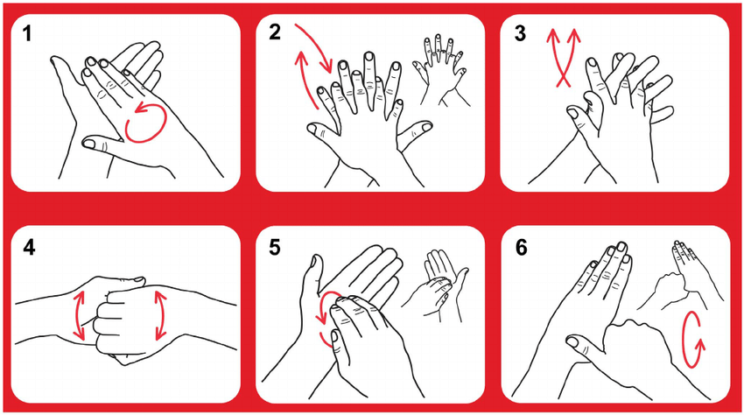
Procedure

Slide 20
Procedure
5- Evaluation
Evaluate if hand enough clean or need for more hygiene

Slide 22
Thanks

